Slide 1
Course 4
Software Quality Assurance
&
Software Quality Models

Slide 2
Software quality assurance
Software development process
Specification of technical requirements
IEEE definition:
1. A planned and systematic pattern of all actions necessary to provide adequate confidence that an item or product conforms to established technical requirements.
2. A set of activities designed to evaluate the process by which the products are developed or manufactured. Contrast with quality control.

Slide 3
SQA – extended [Galin]
A systematic, planned set of actions necessary to provide adequate confidence that the software development process or the maintenance process of a software system product conforms to established functional technical requirements as well as with the managerial requirements of keeping the schedule and operating within the budgetary confines

Slide 4
 | IEEE | Extended
Systematic, planned actions |  | 
Software Development Process |  | 
Software Maintenance |  | 
Functional Technical Requirements |  | 
Scheduling |  | 
Budget control |  | 
ISO 9003
&
CMM

Slide 5
SQ Assurance vs. SQ Control
Systematic activities throughout the development and maintenance – prevent, detect, correct errors
Minimize costs of quality
Set of activities – reject products that do not qualify
Part of SQ assurance activity

Slide 6
Objectives of SQA – process oriented
Software will conform to functional technical requirements
Software will conform to managerial scheduling and budgetary requirements
Improvement and efficiency of software development and SQA – improve technical and managerial requirements + reduce costs

Slide 7
Objectives of SQA – product oriented
Software maintenance activities will conform to functional technical requirements
Software maintenance activities will conform to managerial scheduling and budgetary requirements
Improvement and efficiency of software maintenance and SQA – improve technical and managerial requirements + reduce costs

Slide 8
Software Quality Models
McCall (1977) – classic – 11 factors
Evans & Marciniak (1987) – 12 factors
Deutsch & Willis (1988) – 15 factors
ISO 9126 (2001) – 6 factors
ISO25010 (2011) – 8 factors

Slide 9
Terminology
Hierarchical structure: set of factors with subfactors
Factor/ subfactor = characteristics / subcharacteristics
In McCall model – same subfactor part of different factors
Rest of the models: tree structure

Slide 10
McCall Model
11 factors – grouped in 3 categories:
Product operation factors - deals with requirements that directly affects software operation: Correctness, Reliability, Efficiency, Integrity, Usability
Product revision factors - deals with requirements affecting software maintenance activities: Maintainability, Flexibility, Testability
Product transition factors - deals with requirements affecting adaptation and integration: Portability, Reusability, Interoperability

Slide 11
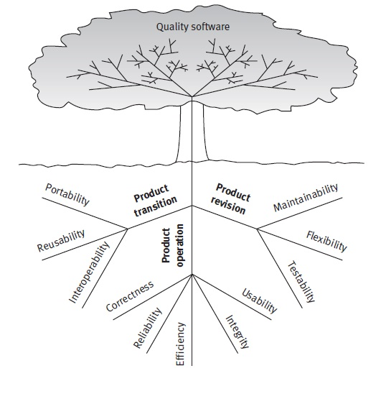

Slide 12
Other models
Evans & Marciniak
Deutsch & Willis
Exclude testability
Add verifiability
Add expandability
Exclude testability
Add verifiability
Add expandability
Add safety
Add manageability
Add survivability
Expandability + survivability – resemble flexibility + reliability
Testability – part of maintainability

Slide 13
FURPS Model
Developed by Hewlett Packard
FURPS:
Functionality - is assessed by evaluating the features and capabilities of the delivered program and the overall security of the system.
Usability - is assessed by considering human factors, overall aesthetics, look and feel and easy of learning.
Reliability - is assessed by measuring the frequency of failure, accuracy of output, the mean-time-to-failure(MTTF), ability to recover from failure.
Performance - is assessed by processing speed, response time, resource utilization, throughput and efficiency.
Supportability - is assessed by the ability to extend the program (extensibility), adaptability, serviceability and maintainability.

Slide 14
ISO 9126 Quality Factors
The ISO 9126 standard identifies six key quality attributes:
Functionality - degree to which software satisfies stated needs.
Reliability - the amount of time the software is up and running.
Usability - the degree to which a software is easy to use.
Efficiency - the degree to which software makes an optimum utilization of the resources.
Maintainability - the ease with which the software can be modified.
Portability - the ease with which a software can be migrated from one environment to the other.

Slide 15
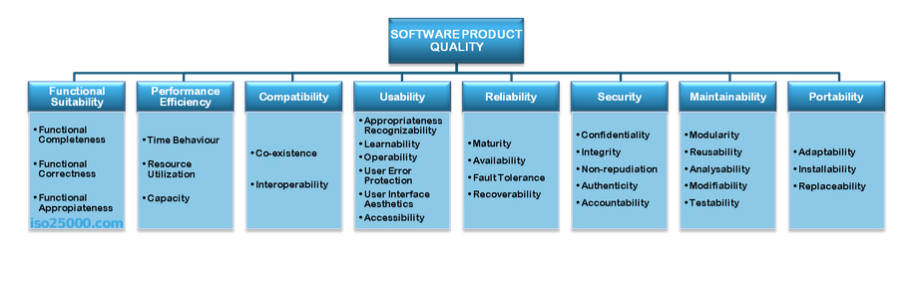
ISO 25010 System and software quality model

Slide 16
McCall model
See McCall.pdf in course directory
Approach:
Determine a set of quality factors
Develop a set of criteria for each factor
Define metrics for each criterion
Validate metrics
Translate results into guidelines
Start with ≈ 55 features - group

Slide 17
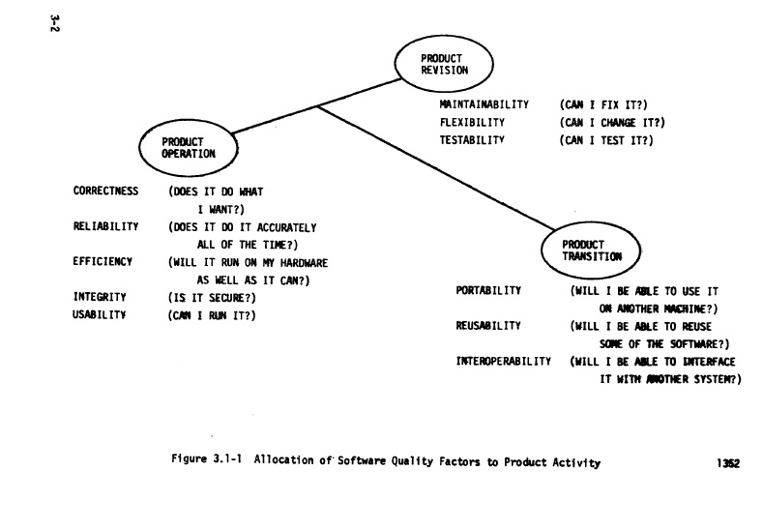

Slide 18
Case study - Correctness
Definition: Extent to which a program satisfies its specifications and fulfills the user's mission objectives.
Life-cycle involvement:
Measured in development: analysis, design, implementation
Impact realized in: testing, operation, maintenance
Criteria:
Traceability
Consistency
Completeness
Criteria definition
Metrics & criteria evaluation

Slide 19
Traceability: Those attributes of the software that provide a thread from the requirements to the implementation with respect to the specific development and operational environment.
Consistency: Those attributes of the software that provide uniform design and implementation techniques and notation.
Reliability + Maintainability
Completeness: Those attributes of the software that provide full implementation of the functions required.

Slide 20
Metrics for criteria
McCall.pdf:
pg 64 – Computation
pg 90 - Explanation

Slide 21
Project assignment:
1st step: choose your SQ model

Slide 22
Portability

Slide 23
Portability
Definition: Effort required to transfer a program from one hardware configuration and/or software system environment to another.
Impact:
Measured:
Design
Code
Realized: transition

Slide 24
McCall
Portability
Modularity
Self-descriptiveness
Machine Independence
Software System Independence
explanations
Also in maintainability, testability, portability & reusability
struct. of indep. modules
in other 6 factors
hardware indep.
also in reusability
indep. of OS, utilities, I/O
also in reusability

Slide 25
ISO25010
Portability
Adaptability
Instability
Replaceability
Degree of effectiveness and efficiency with which a product or system can be successfully installed and/or uninstalled in a specified environment
Degree to which a product can replace another specified software product for the same purpose in the same environment.
Degree to which a product or system can effectively and efficiently be adapted for different or evolving hardware, software or other operational or usage environments

Slide 26
Why?
Software life ≈15 years vs. hardware life ≈ 4-5 years
Software implemented ≈ 3 hardware config.
Porting less expensive than implementing
Greater market

Slide 27
The 7 dimensions of portability
Operating systems
Processor architecture
Compiler & language features
GUI environment
Regions
Hardware devices
…

Slide 28
Issues in OS portability
standardization
I/O, encode char, organize files, allocate resources
POSIX - API
Functionality not included in standard: web server, database engine, mail transfer engine
Compatibility/ emulation layer
Application binary interface
Notes:
POSIX - Portable Operating System Interface", is a family of standards specified by the IEEE for maintaining compatibility between operating systems. Define API

Slide 29
Issues in Processor Architecture portability
Data type properties – size + operations
Data representation – alignment
Machine-specific code
JAVA

Slide 30
Approaches in GUI portability
Ignore: platform dependent app.
Emulation layer: use libraries for transformation
Portability layer: isolate GUI elem.
Portable platform: ex. Java – own API for GUI
HTML or AJAX-based layer
Mobile application
Notes:
Emulation: ex. Calls to Microsoft Foundation Class transf. to X Windows System; the only difference: how header files are included and the libraries that are linked
HTML AJAX – portable platform – slow – in browser

Slide 31
Issues in region portability
Internationalization: generalization process of creating programs that can be easily ported across different regions
Localization: particularization effort required to port a program to a given region
Character set
Cultural issues
Messages
Date
Time
Currency

Slide 32
Portability today
SOA
Less technology dependant
Open Source
Less coding, more composition
Internal platform independence through SOA
Portability of parts
Tinderbox
http://www-archive.mozilla.org/projects/tinderbox/

Slide 33
Portability metrics
Adaptability
Change to new specs or operating environments
Instalability
effort required to install the software
Replaceability
plug&play of compon.
Conformance
Similar to compliance for functionality
Compliant with … [Yes/no]
Deployment + installation
Compliant with 3rd party compon: DB, app. Server
Compatible with… [Yes/No]
Difficult to evaluate

